Slide 1
MongoDB Scan 161094 – Divansh Anupam

Slide 2
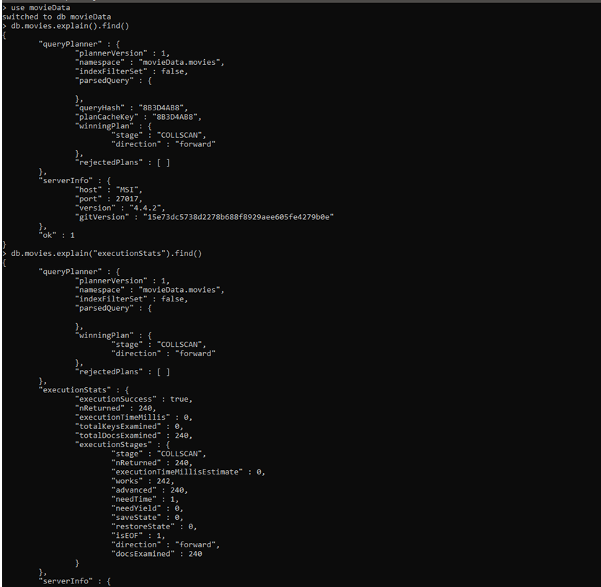
COLLSCAN

Slide 3
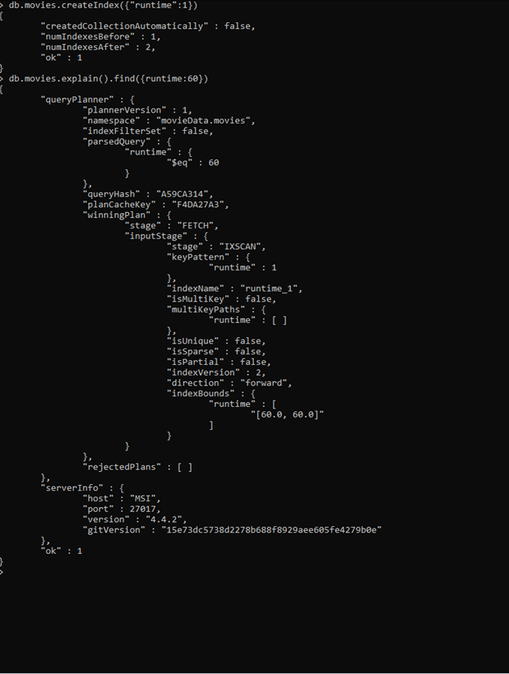
IXSCAN

